Slide 1

Group 3
INTRODUCTION
Merlin
Our magic like creation that takes the time to get to know you and gives sage advice.
The Team
Daniel Froom, Demi Oyebanji, Anna Toaze, and Suleiman Abdul Samad

Slide 2
Merlin Brings Personalized Advice to the Masses
Merlin’s guidance shows the path in a sea of confusion
Historically personalized financial advice has been an exclusive service offered to those with high net worth. Merlin brings detailed financial advice to the masses, and brings clarity to your financial decisions.
Merlin covers the whole gamut
Tax advantaged investment accounts, investing, tax planning, saving, mortgages, loans, retirement and more all made simple.
Merlin’s natural speech puts you at ease
While often even human financial planners often sound uptight and stuffy, Merlin speaks to you in a way you can understand and relate to. Merlin distills complex concepts so they’re easy to understand.

Slide 3
Saving and Investing Made Easy
With Merlin as your guide its easy to get on track
Merlin is Here to Help
Invest
By now Merlin has become a trusted ally and you’re seeing your money grow- like magic!
No matter your starting point Merlin can help you work towards your financial goals and dreams.
Bolster Saving
Merlin’s sage advice, guidelines, and encouragement help you work towards your saving goals.
Identify Waste
Merlin finds waste and makes it disappear, like magic, to help you keep more of your money.
Asses
Merlin starts by learning about and assessing your financial situation.

Slide 4
Roadmap to Full Experience
Our path to enabling Merlin to guide all of Camelot- not just Arthur
Current Iteration
Using Lex as Merlin’s sole source of all the users Financial information.
V2
Use Plaid to source detailed Banking and financial data and use Lex to follow up with any questions or further detail needed for Merlin.
V3
Using Lex to directly answer specific questions the user may have about their financial situation and future goals.

Slide 5

Combining Technologies Creates Magic
The Birth of Merlin and his Quest to bring Prosperity
Dynamo DB & Lambda
Lex
SageMaker
Amazon Lex allows Merlin to converse with the client and elicit the information necessary to work his magic.
SageMaker is Merlin’s brains where the calculations, comparisons, and algorithms are run to provide useful information and advice back to the client.

Slide 6
Let’s Meet
MERLIN
Lex
Merlin’s chat bot is run on Amazon Lex, which allows us to rapidly build in new features.
Arthur
Arthur is our fictional client. While we picture Arthur as a young prince at the start of his journey, we will let you guys choose most of his characteristics to demonstrate the code actually works.

Slide 7
Backend, Integrations, and Code
Take a peak with us at the magic behind the curtain
Lambda
SageMaker
Dynamo DB
S3

Slide 8

ANY QUESTIONS?

Slide 9
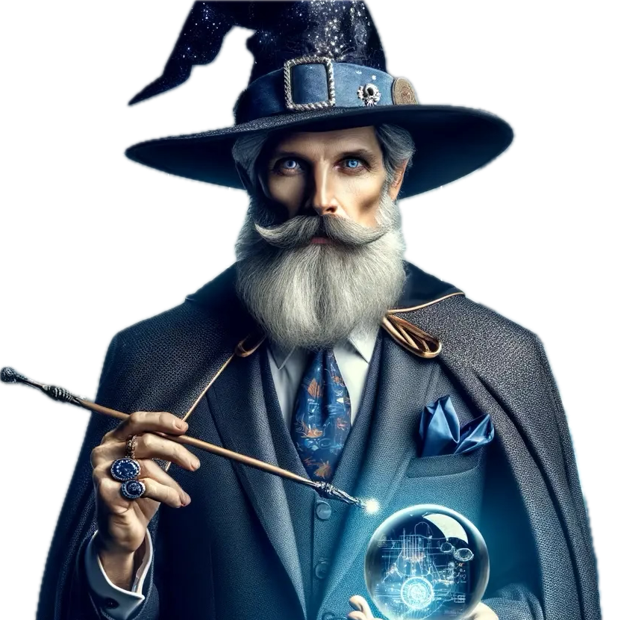
THANK
YOU
Your participation makes presentations like these truly interactive and much more enjoyable.
It was a pleasure to work with you Arthur!

